Slide 1
Jermyn Borough Council Meeting
02/20/2025

Slide 2
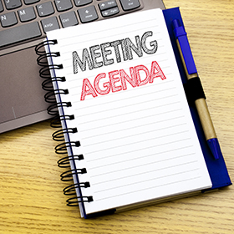
Meeting Agenda
February 20, 2025
CALL TO ORDER
PLEDGE OF ALLEGIANCE
ROLLS CALL
PREVIOUS MEETING MINUTES
TREASURER REPORT/BILLS PAYABLE
SECRETARY REPORT
CORRESPONDENCE
PUBLIC COMMENT
PROFESSIONAL REPORTS-POLICE, FIRE, SOLICITOR, ZONING, ENGINEER, TAX COLLECTOR, MAYOR
COMMITTEE REPORTS-SAFETY, PLANNING, FINANCE, SHADE TREE, REC, MS4, DPW
IT UPGRADE INFO
PAVING PROJECT ADVERTISEMENT
RUSHBROOK CREEK PROJECT
NEW BUSINESS

Slide 3
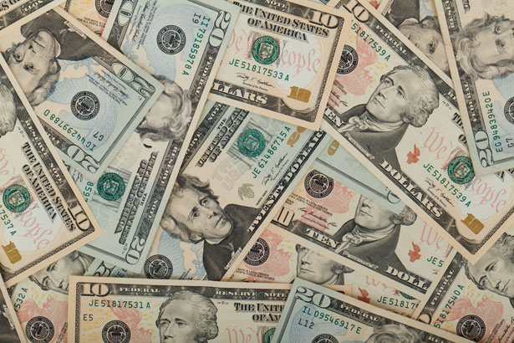
Treasurer’s report
2/20/2025
ASSETS
Checking/Savings
American Rescue Plan Fund 94,580.01
Capital Reserve - DPW 1,040.69
Capital Reserve - Police 6,394.82
Crime Watch Fund 222.69
General Fund - Community 71,403.33
General Fund - FNB 3,602.56
Holiday Lights Fund 400.59

Slide 4
Treasurer’s report
Investment - General Fund 1,125.24
Investment - Liquid Fuels 24,775.47
Investment - Paving Fund 1,136.95
Investment - Recycling 124.26
Investment - Refuse 177.19
Liquid Fuels - FNB 298.96
Petty Cash 194.00
Recreations Fund 28,467.15
Recycling - Community 6,396.07
Refuse Checking - FNB 59,872.00
Total Checking/Savings 300,211.98

Slide 5
Treasurer’s report
200000 · Accounts Payable 13,911.19
Long Term Debt 80,180.58

Slide 6


